Slide 1
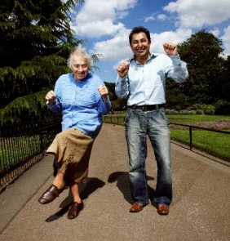
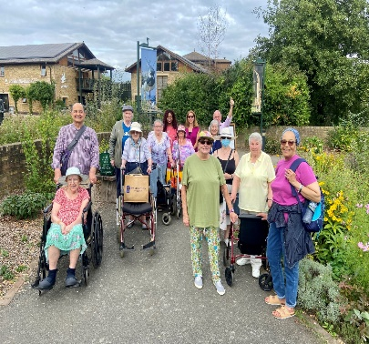
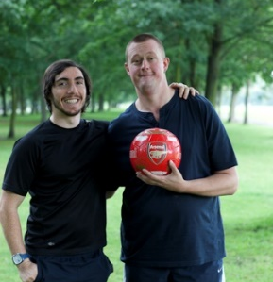
The Creighton Centre
Volunteer Opportunities
Volunteer Role | Project | Description | Availability & Commitment | Location/s | Contact details
Exercise / Walking support Volunteer | Keep Active | Support an isolated older person (60+) with gentle exercises and/or outdoor walking, as prescribed by NHS community rehab teams. Involves providing company, encouragement and motivation for clients to regain independence after a fall, illness or hospital stay. | Flexible (weekdays and weekends, daytime and evening). Visit a client once per week for 9 weeks. Each visit approx. 1-1.5 hours. | H&F - In clients home or outdoors in their local community. | Hassan Kosa hkosa@creightonhouse.org Tel: 020 7385 9689 (option no. 6)
Befriending Volunteer – telephone befriender | Homeline | Telephone befriending calls for isolated older people (60+), to enjoy a friendly chat and to monitor wellbeing (Mon-Fri & weekend rotas available). | Flexible (weekdays and weekends, daytime and evening). We ask that volunteers make calls between the hours of 10am – 5pm. | All calls can be made remotely from the comfort of your home! | Jelena Radusinovic homeline@creightonhouse.org Tel: 020 7385 9689 (option no. 1)
Befriending Volunteer – home visitor | Homeline | Long term home visits to lonely & isolated clients. Involves activities such as chatting, walking, playing games, reading, helping with paperwork, providing a listening ear. | Visit a client once per week, fortnightly or occasionally for 1-2 hours. A commitment of 1 year is expected. | H&F - In clients home or outdoors in their local community. | Jelena Radusinovic homeline@creightonhouse.org Tel: 020 7385 9689 (option no. 1)
Befriending Volunteer – Social events/trips | Homeline | Monthly lunches/afternoon teas for members of befriending service. Friendly and helpful volunteers required to support staff setting up/cleaning, serving drinks/food and chatting to members. Occasional trips out where volunteers help to push wheelchairs, chat with members and assist with refreshments. | Monthly – usually last Monday of each month. | The Creighton Centre | Jelena Radusinovic homeline@creightonhouse.org Tel: 020 7385 9689 (option no. 1)
Befriending Volunteer – IT Club | Homeline | Monthly lunches/afternoon teas for members of befriending service. Friendly and helpful volunteer sort to support staff serving drinks/food, providing conversation. | Visit a client once per week, fortnightly or occasionally for 1-2 hours. | The Creighton Centre | Jelena Radusinovic homeline@creightonhouse.org Tel: 020 7385 9689 (option no. 1)
Volunteer Mentor | Learning Disability Outreach Services | One to one mentor for an adult with learning disabilities. Involves various tasks including; advice, guidance, basic advocacy, emotional support and social engagement within the clients local community. | Meet with mentee at least once a fortnight for 1-2 hours. A commitment of 1 year in the role is expected. | H&F – initial meeting to take place at The Creighton Centre but further meetings can take place in the local community. | Joe Robins jrobins@creightonhouse.org Tel: 020 7385 9689 (option no. 4)
The Creighton Centre 378 Lillie Rd. London SW6 7PH T: 020 7385 9689 | info@creightoncentre.org | creightoncentre.org
Bishop Creighton House Settlement operating as The Creighton Centre Registered Charity in England No.1059084 Company Limited by Guarantee No.3217598 VAT No.782 5903 03

